Slide 1
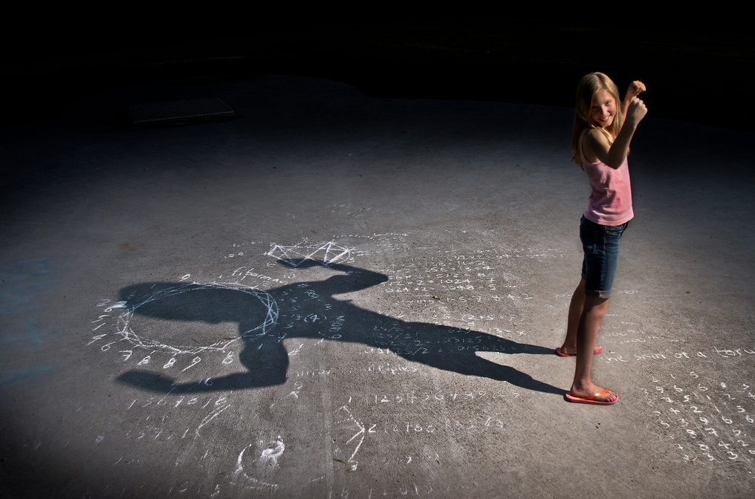
Be Courageous
Joshua
Dr. Rick Griffith • Crossroads International Church Singapore
CICFamily.com • BibleStudyDownloads.org

Slide 2
Starting a School in 1992
no money no backers no parents no teachers no principal no campus
Notes:
One of the greatest challenges of my life was helping begin a K-12 international school. It soon became quite discouraging to me to realize that we had… [list above]

Slide 3
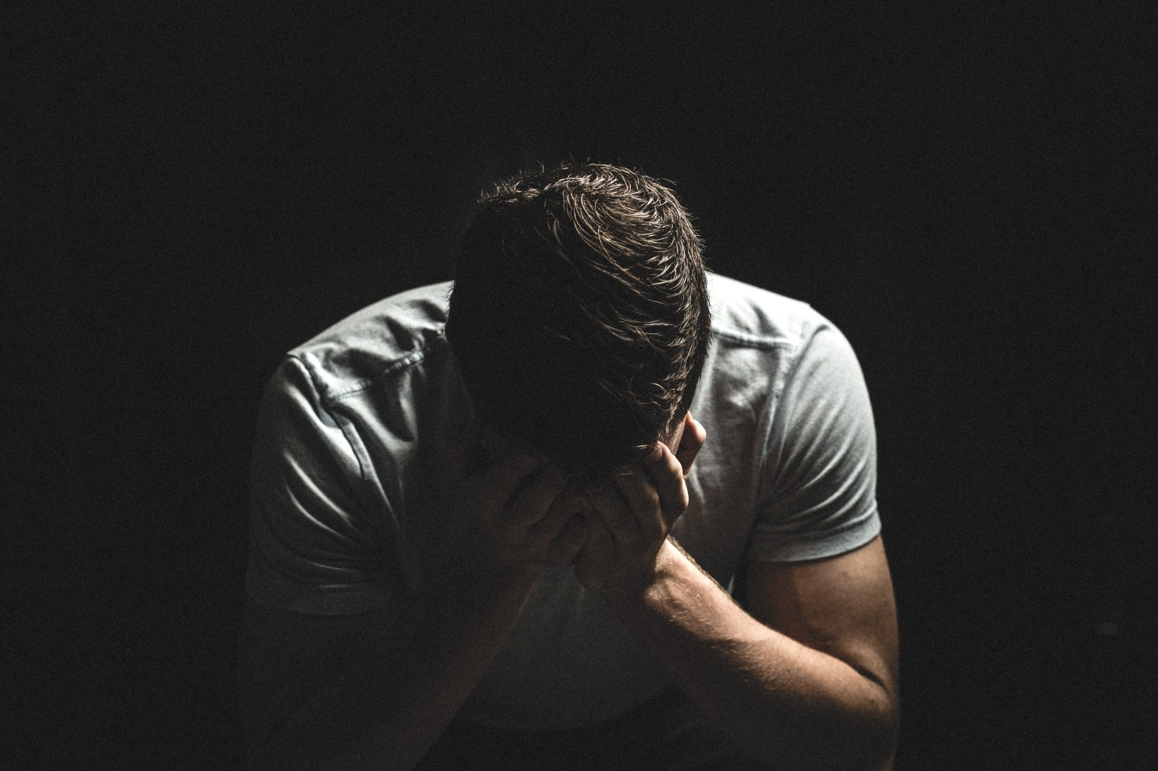
Discouragement
Notes:
Discouragement hits us all.

Slide 4
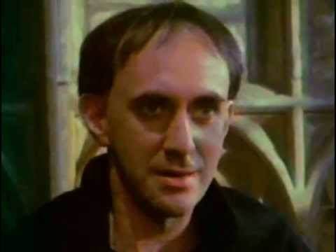
Discouragement
Notes:
Discouragement was real to an obscure monk roughly 500 years ago.

Slide 5
Discouragement
Martin Luther's parents were pious people, but they were shocked when he abandoned his legal studies at Erfurt and entered the Augustinian monastery. Martin was 21 years old when, in July 1505, he gave away all his possessions—including his lute, his many books and clothing—and entered the Black Cloister of the Augustinians.

Slide 6
Discouragement
Notes:
But being a monk made Luther's discouragement even worse. He would spend hours each day confessing every sin he could think of. But no peace of mind came.

Slide 7
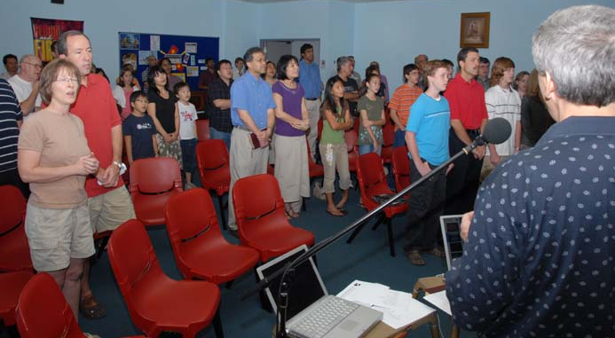
First Worship Service 19 November 2006
Notes:
Our church had a very encouraging start with 58 people at our first service.

Slide 8
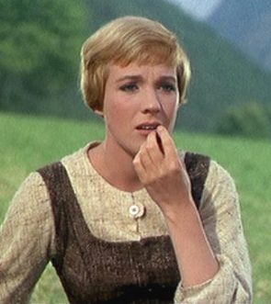
Bank Balance
Why?
Decreased Offerings
$1001/week decrease in offerings
• Oct 07-Sept 08 = $1620/week
• Oct 08-Nov 08 = $ 619/week
Unpaid Bills
$16,700 unpaid rent
$2,573 legal fees
Higher Monthly Costs
$2600 Honorariums
$1452 Rent Increase
$300 Church Dinner
Notes:
But two years later the economic crisis hit us hard.
__________
Honorariums = Tom ($1000), Susan ($1000), Enriko ($300), Amaraa ($300), guest speakers not par of our body ($100/sermon)

Slide 9
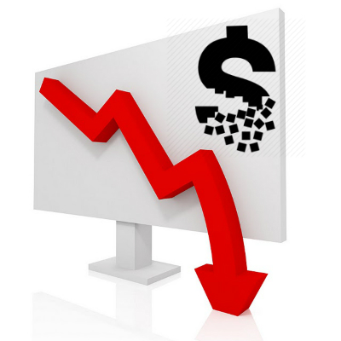
The Bottom Line
At the present rate of $600 weekly offerings and $2000 weekly expenses, our $7300 bank balance will be gone in 5.2 weeks.
Notes:
So I shared this PPT slide with the people. Our church in 2008 had no money, no backers, no morning worship slot, one part-time pastor, and frequent turnover of internationals. It was discouraging.

Slide 10
Are you discouraged?
Notes:
Are you discouraged? How would you know if you are?

Slide 11
The "Good Ole Days"
Notes:
When discouraged, we tend to look back at the “good ole days” instead of looking forward.
Which way are you looking?

Slide 12
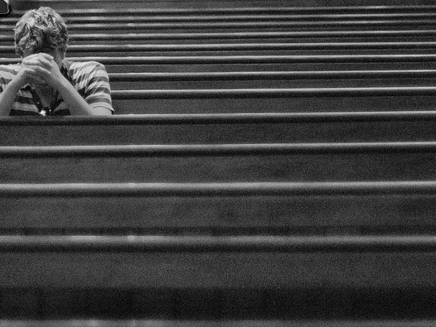
Discouragement

Slide 13
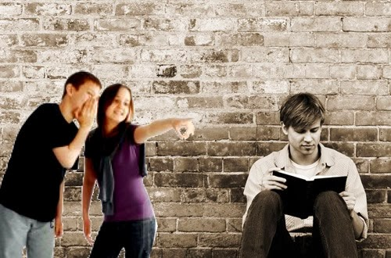
Discouragement
Notes:
Discouragement sometimes comes when we’re ridiculed for our faith.

Slide 14
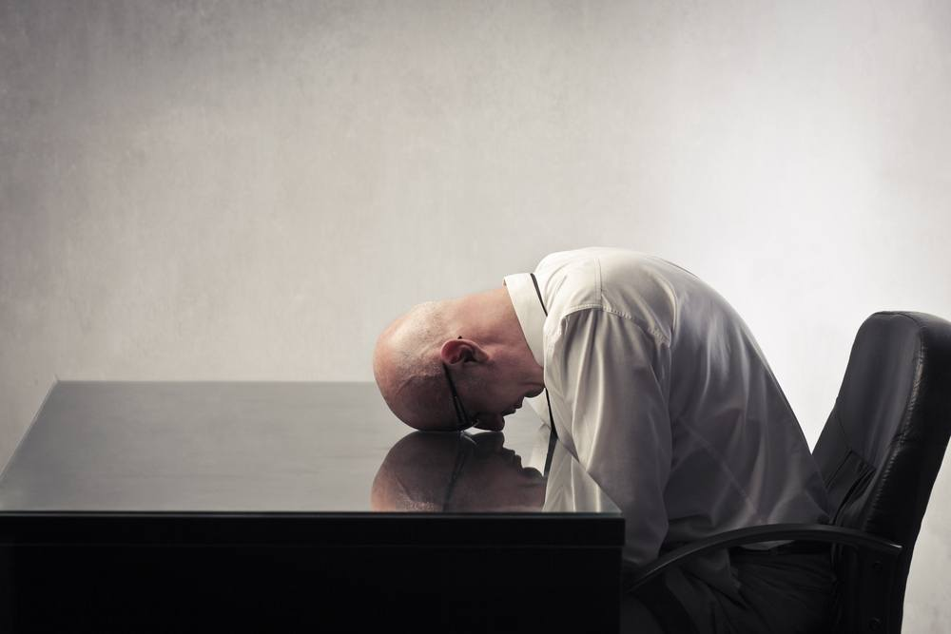
Discouragement
Notes:
It comes when we feel that it is the same ol' same ol' and we lack purpose.

Slide 15
Discouragement.
courage
Notes:
Discouragement means lack of courage.
• The word "courage" is the root word, you know.
• When courage is missing, life makes no sense.
So we need courage! But what does it look like?

Slide 16
Courageous (The Movie)
Notes:
The movie plays automatically

Slide 17
Courageous (The Movie)
Notes:
Discouragement hits us all.

Slide 18
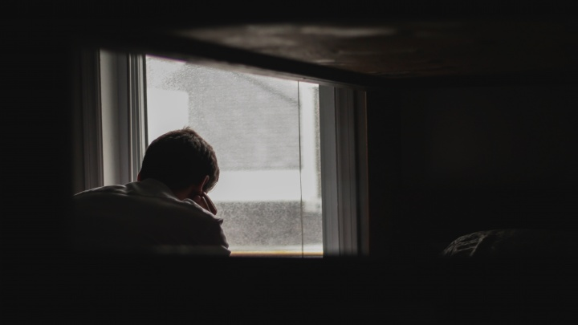
Do you need courage today?

Slide 19
How can you defeat discouragement that prevents you from doing God’s will?
Notes:
How can you have the courage you need to serve the King?

Slide 20
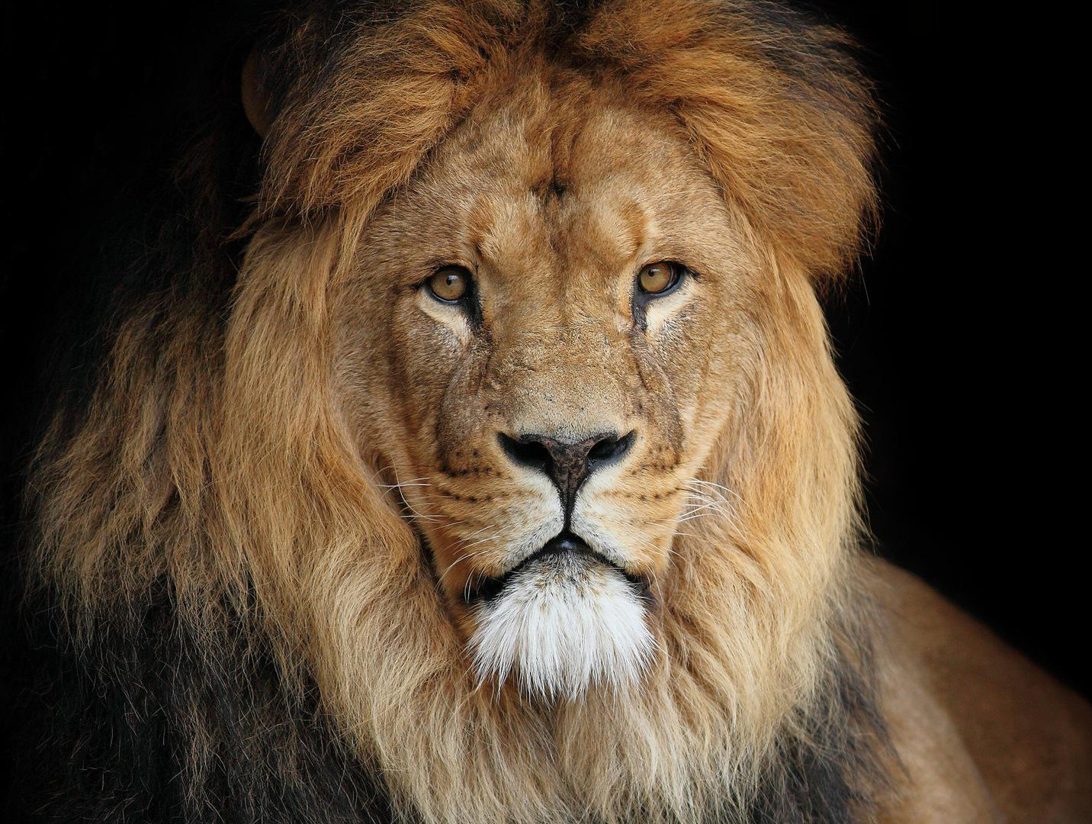
How can you gain courage that enables you to do God’s will?
Notes:
The reality of discouragement is something that everyone faces.
We all must see that God has a solution for discouragement—a way that we can be infused with courage.

Slide 21
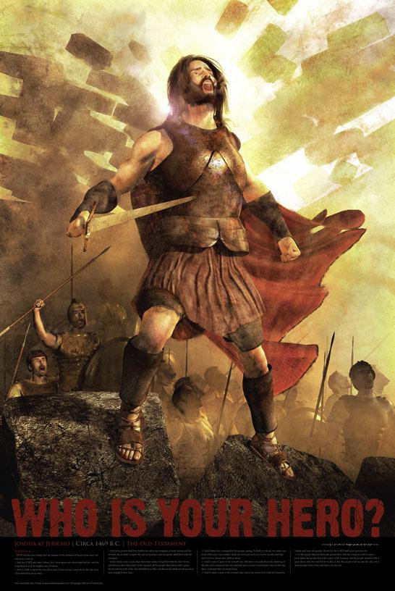
JOSHUA
MISSION
IMPOSSIBLE
OCCUPATION
Dr. Rick Griffith, Singapore Bible College
BibleStudyDownloads.org
Notes:
The reality of discouragement is something that everyone faces.
We all must see that God has a solution for discouragement—a way that we can be infused with courage.
Today we will study a man named Joshua who embodied courage.

Slide 22
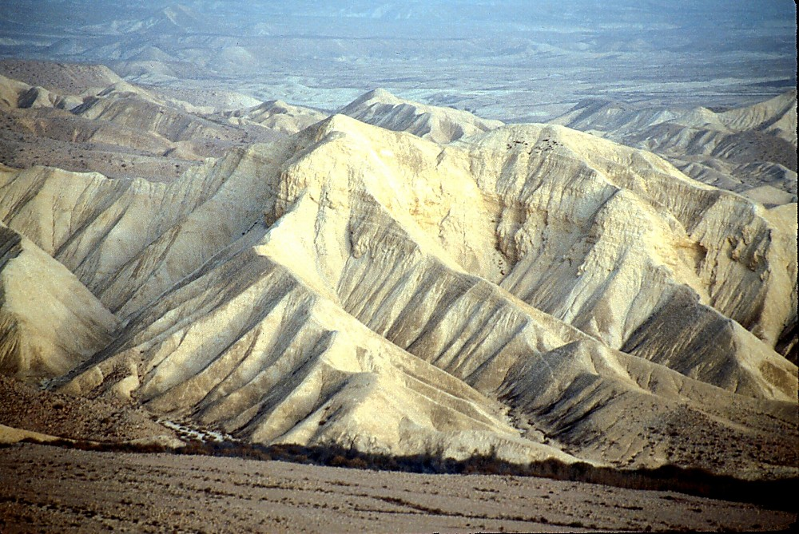
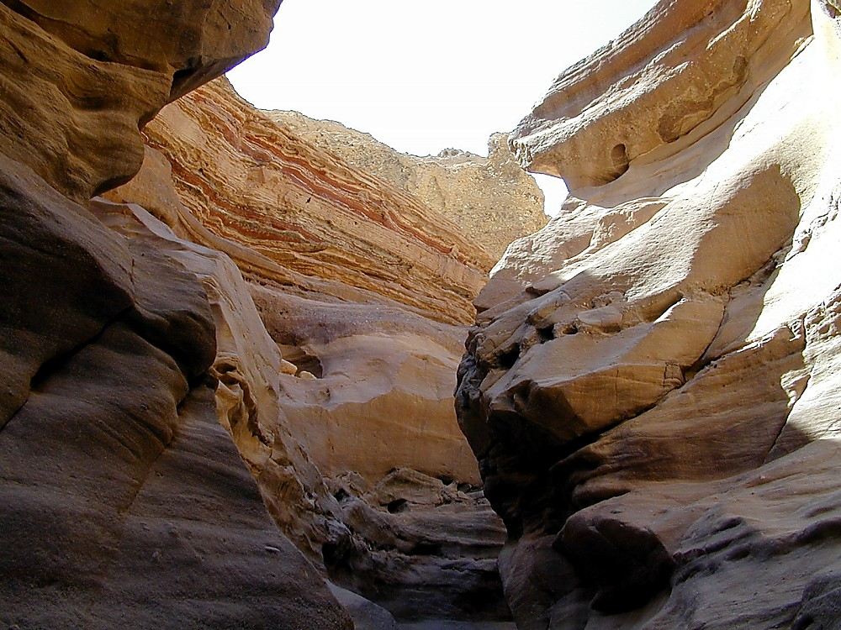
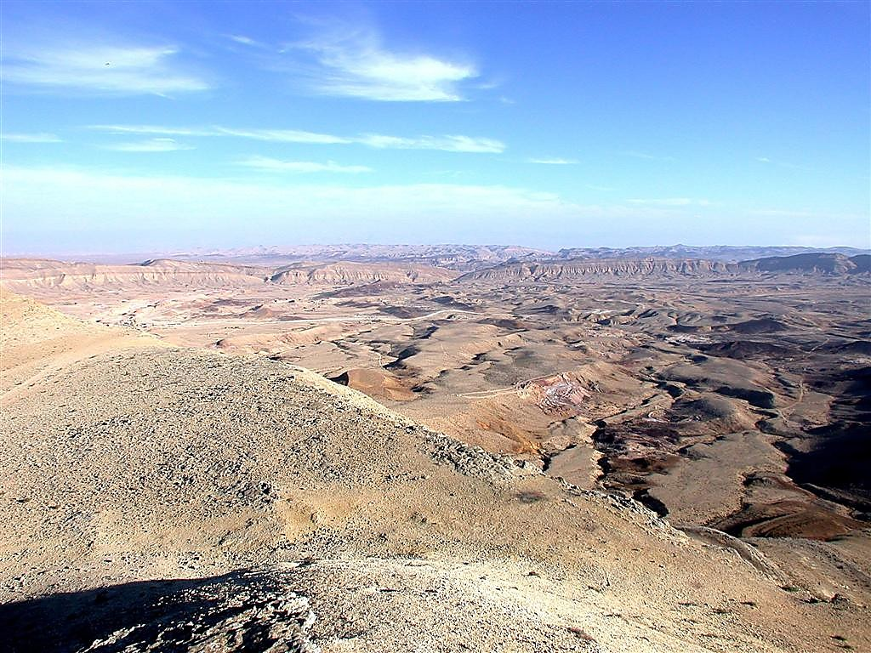
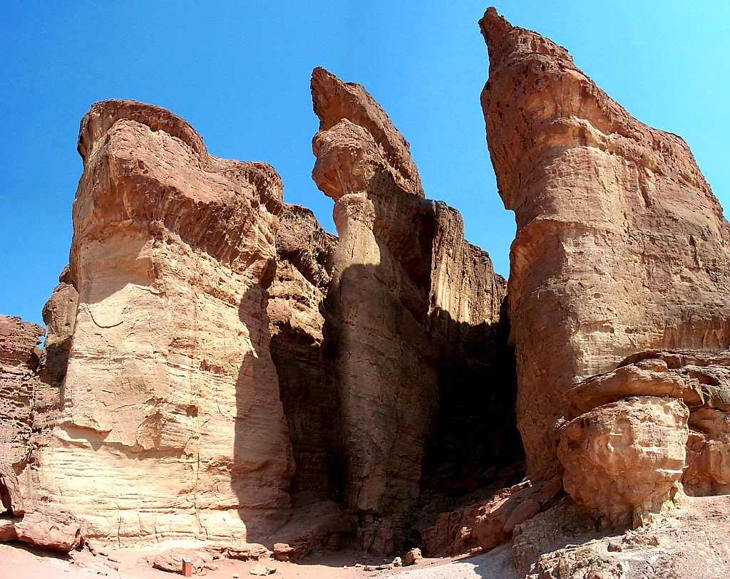
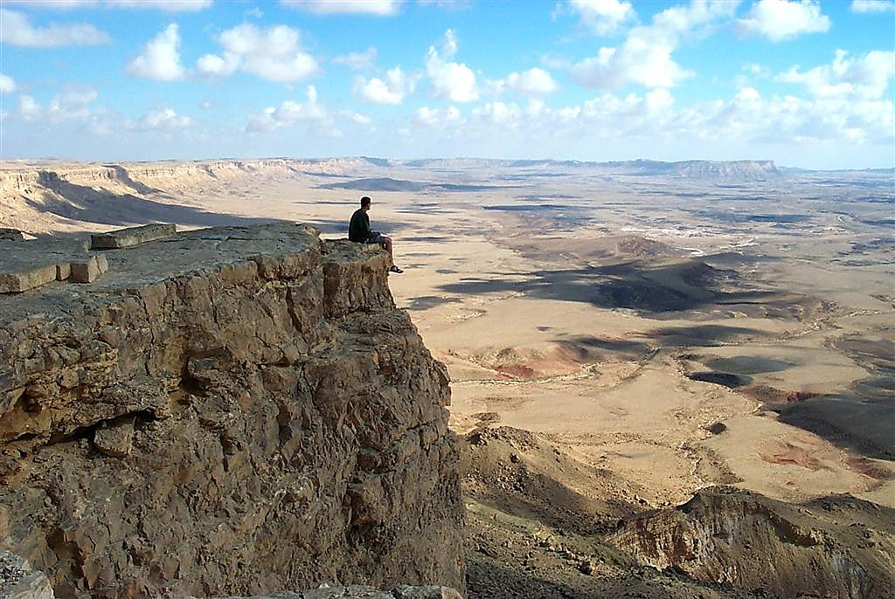
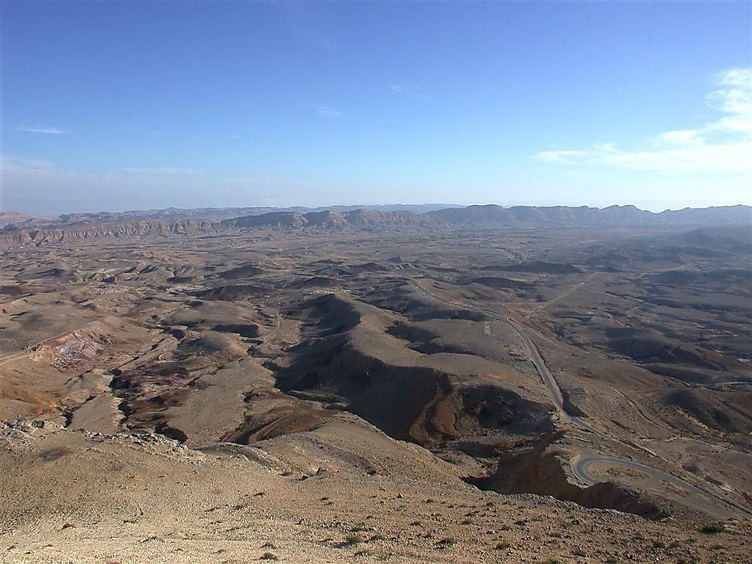
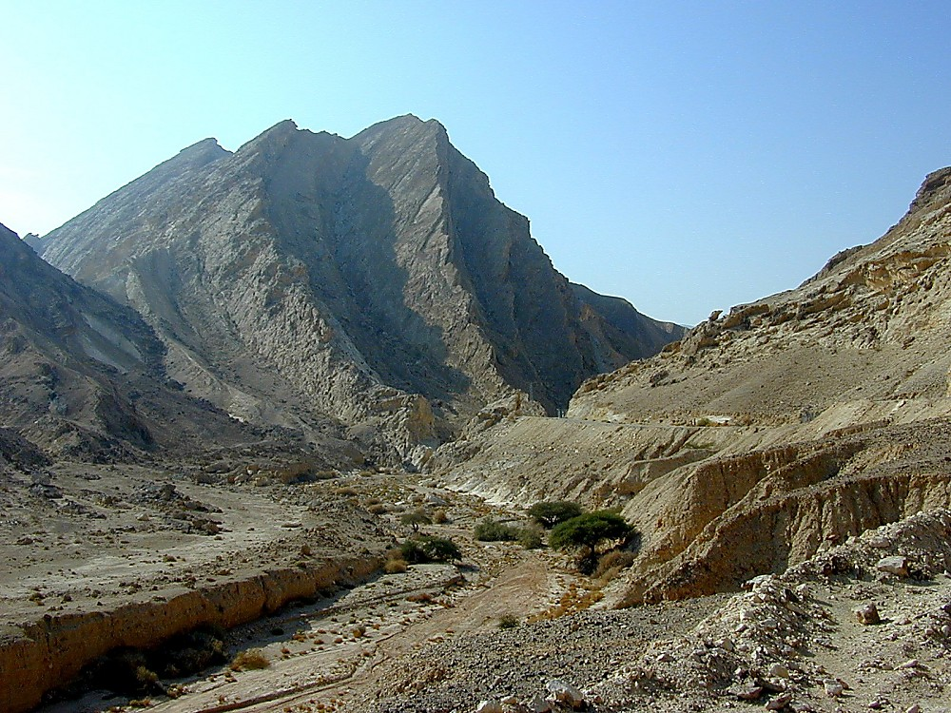
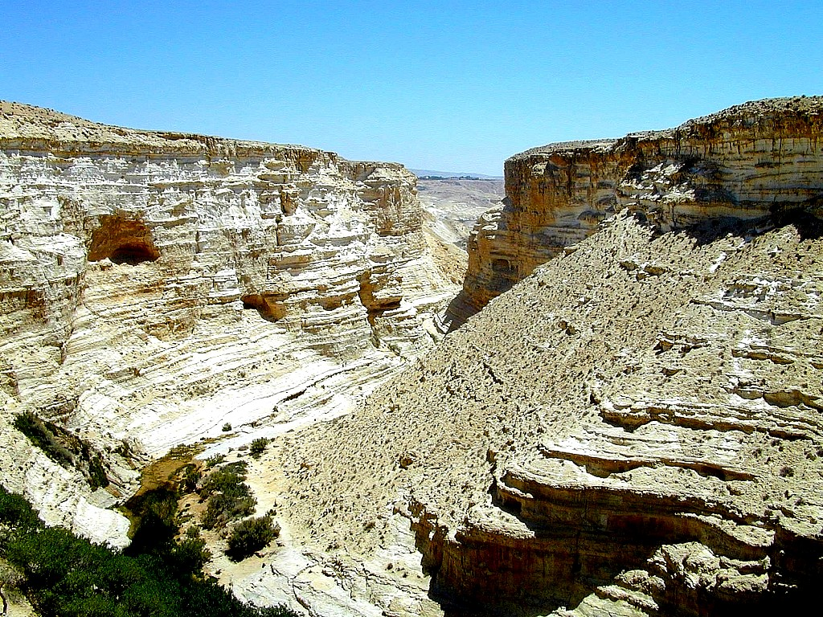
YOU MEAN… 40 YEARS? OUT HERE?
Num. 32:13
DRESSING
THE
STAGE
YOU MEAN… 40 YEARS?OUT HERE?
YOU MEAN… 40 YEARS? OUT HERE?
MOSES
Exodus
Sinai
M - C - C
Kadesh Barnea
40
40
Handbook pg. 26-29
23
Notes:
Israel had been beaten down for 40 years and saw everyone over age 20 die.

Slide 23
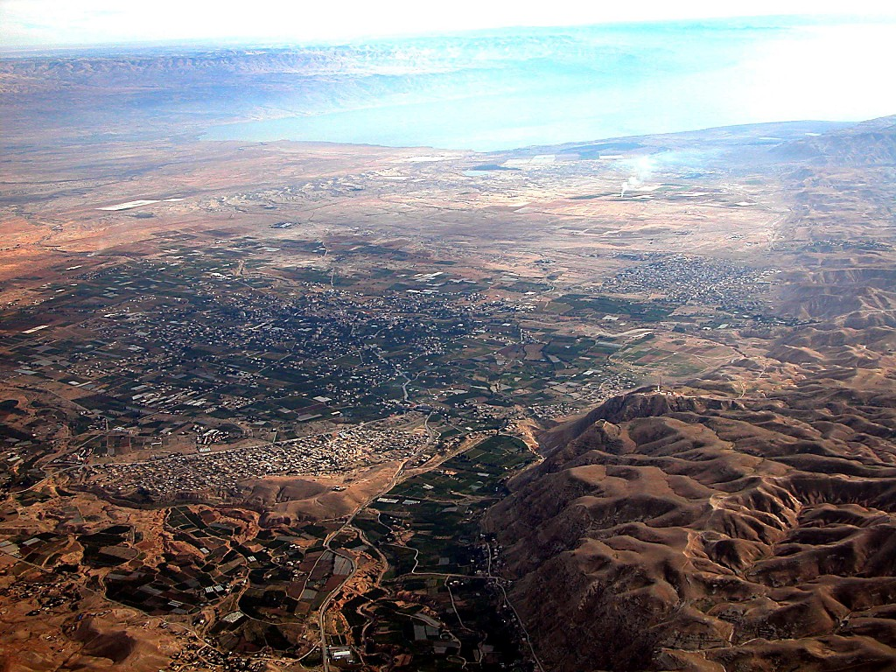
Jericho
DEAD SEA
JORDAN RIVER
MODERN JERICHO
JOSHUA
Jericho/Ai
ANCIENT JERICHO
From Jericho...
Looking East Across the Jordan River
Handbook pg. 26-29
42
Notes:
What turned them around? What turned them from discouragement to be courageous?

Slide 24
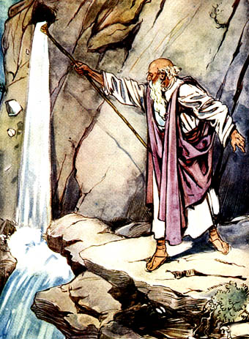
Birth of a People
Exodus
Leviticus
Numbers
Joshua
Them
Formation
Sanctification
Preparation
Occupation
Us
Salvation
Instruction
Walk
Reward
Notes:
OTS Exodus 02.30
OTS Leviticus 03.23
OTS Numbers 04.23
OTS Joshua 06.06
OTS Judges 07.02

Slide 25
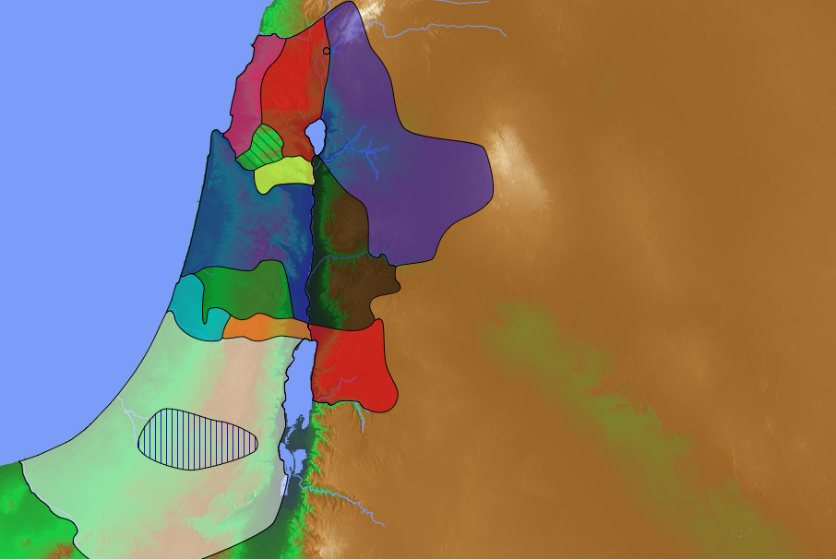
KEY WORD
OCCUPATION
162
KEY WORD

Slide 26
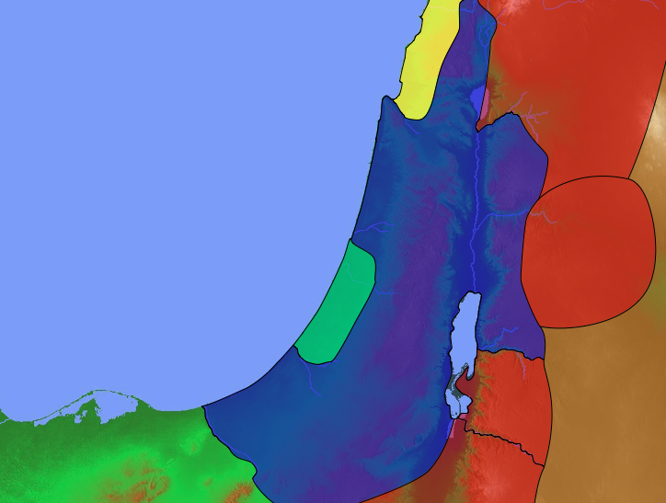
Conquest Promise
Lebanon
Euphrates
Joshua 1:3-5 NLT
"I promise you what I promised Moses: ‘Wherever you set foot, you will be on land I have given you— ⁴from the Negev wilderness in the south to the Lebanon mountains in the north, from the Euphrates River in the east to the Mediterranean Sea in the west, including all the land of the Hittites.’ ⁵No one will be able to stand against you as long as you live. For I will be with you as I was with Moses. I will not fail you or abandon you."
Canaan
Egypt
Negev
Notes:
Yet the possibility of discouragement must have faced Joshua, who had to fill the sandals of Moses! Who could imagine taking over from the only person ever with whom God talked face to face! So God told him…

Slide 27
"Be strong and courageous, for you are the one who will lead these people to possess all the land I swore to their ancestors I would give them. ⁷Be strong and very courageous. Be careful to obey all the instructions Moses gave you. Do not deviate from them, turning either to the right or to the left. Then you will be successful in everything you do. ⁸Study this Book of Instruction continually. Meditate on it day and night so you will be sure to obey everything written in it. Only then will you prosper and succeed in all you do. ⁹This is my command—be strong and courageous! Do not be afraid or discouraged. For the Lord your God is with you wherever you go”" (Joshua 1:6-9 NLT).
Notes:
Joshua was one of the twelve spies who surveyed the land of Canaan 39 years earlier. He had shown himself faithful to trust in the LORD to bring them into Canaan.
However, Moses had just died (Joshua 1:1-2) and in many ways Joshua was untested as a leader of all Israel.

Slide 28
How can you defeat discouragement that prevents you from doing God’s will?
Notes:
What do we need to conquer discouragement and what results from it? That's what we will see today.
The entire book of Joshua helps us defeat discouragement.
Joshua tells us first that we can conquer discouragement when we…

Slide 29
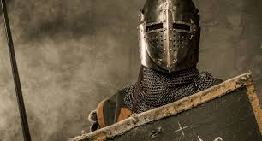
I. Act like God will keep his Word (Joshua 1–12).
Notes:
Discouragement is inaction, so serve God with faith in his promises.

Slide 30
Slides on Joshua 1

Slide 31
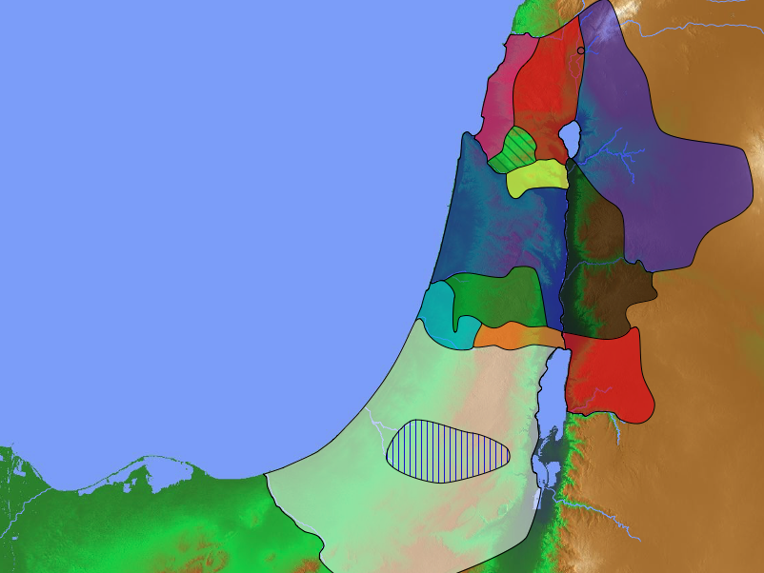
The Agreement with the Eastern Tribes
140
Manasseh
Numbers 32
Gad
Reuben
Notes:
Israel conquered most of Canaan by courageous actions based on God fulfilling his promise (Joshua 1–12).
But Joshua had already seen God's faithfulness to clear the land east of the the Jordan for three tribes.

Slide 32
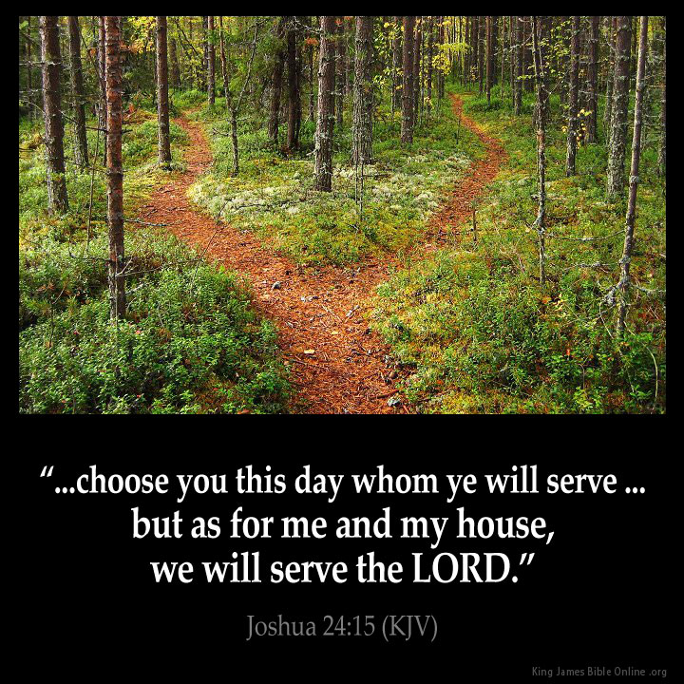
The Goal & the Means
Asher
Naphtali
TRIBAL RESPONSIBILITIES
Manasseh
Zebulun
Issachar
Manasseh
Ephraim
Gad
Dan
Reuben
"Choose this day whom you will serve… but as for me and my house, we will serve the LORD" Joshua 24:15
Benjamin
Judah
Simeon
Notes:
The goal was to give land to all the tribes, but the means was to do this by serving the LORD, which Joshua affirms in the final chapter.

Slide 33
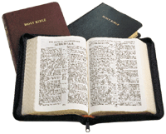
KEY VERSE
162
Key Verse
"Do not let this book of Law
depart from your mouth;
meditate upon it
day and night, so that you
may be careful to do
everything written
in it. Then you will be
prosperous and successful"
——Joshua 1:8——
Notes:
The way they were to serve the LORD was first to base their lives on what Moses had already written.

Slide 34
Slides on Joshua 2

Slide 35
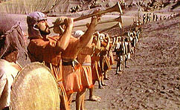
JERICHO
JERICHO

Slide 36
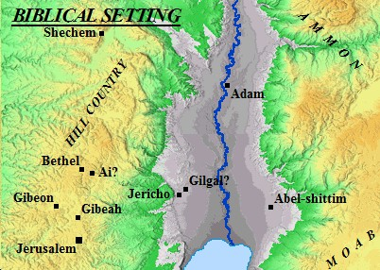
Location of Jericho

Slide 37
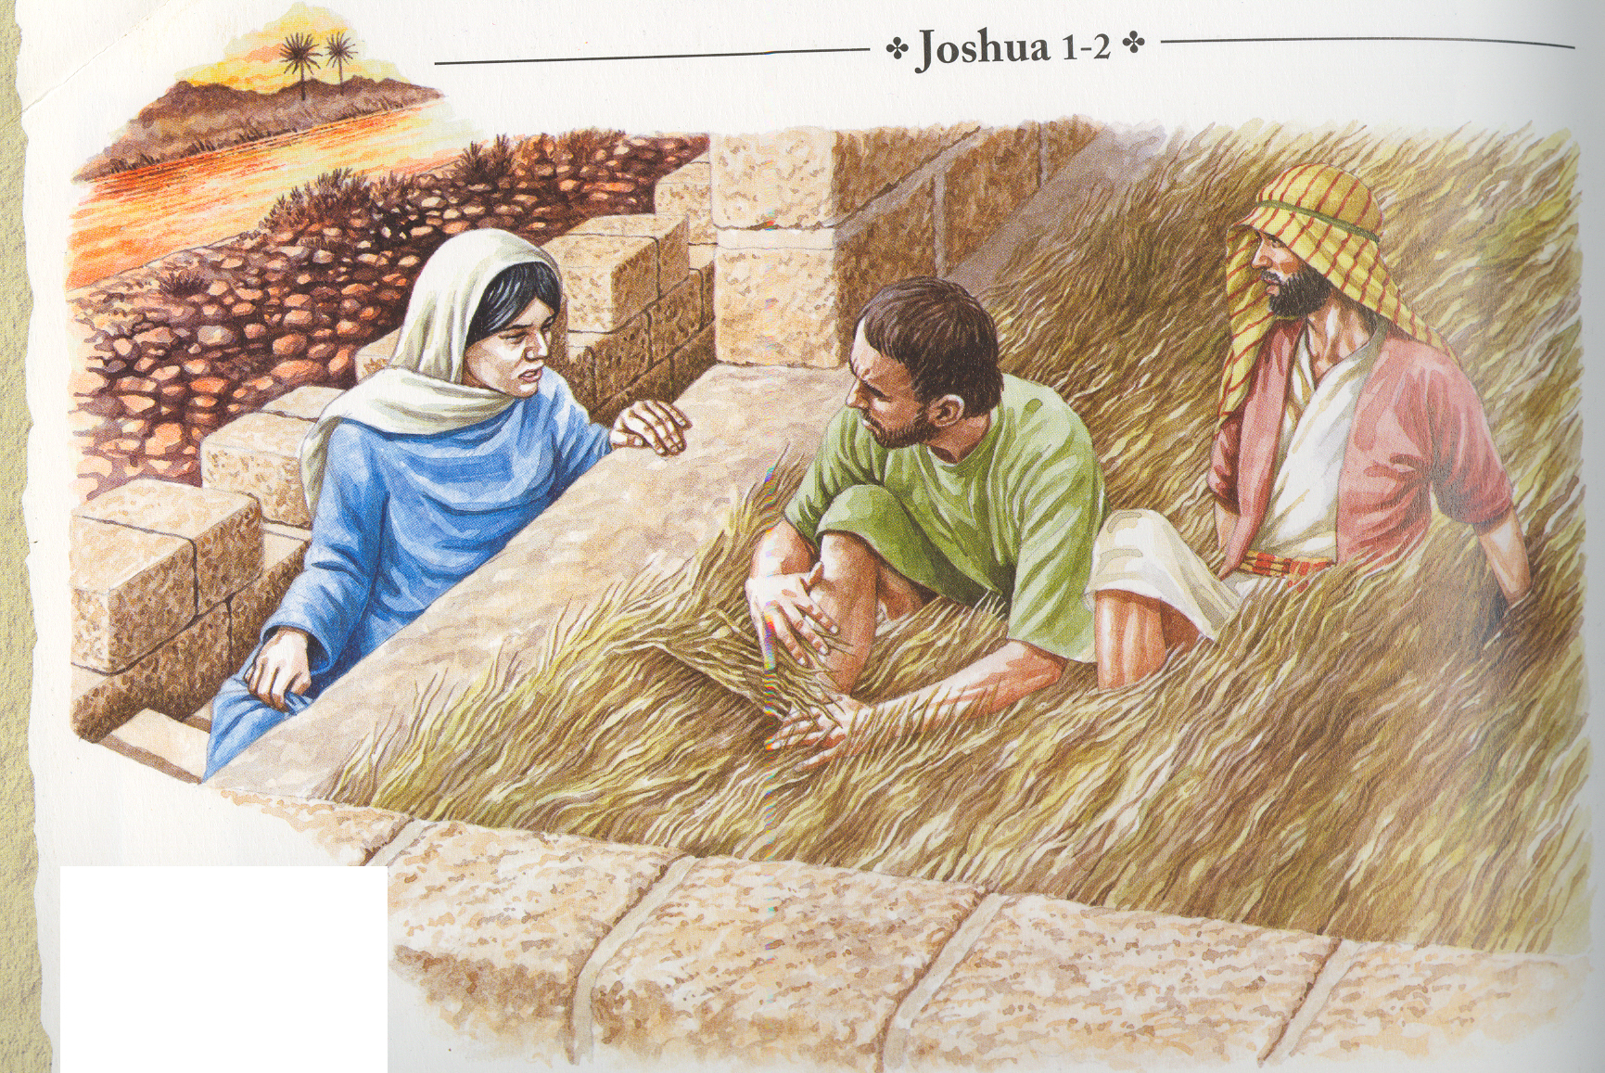
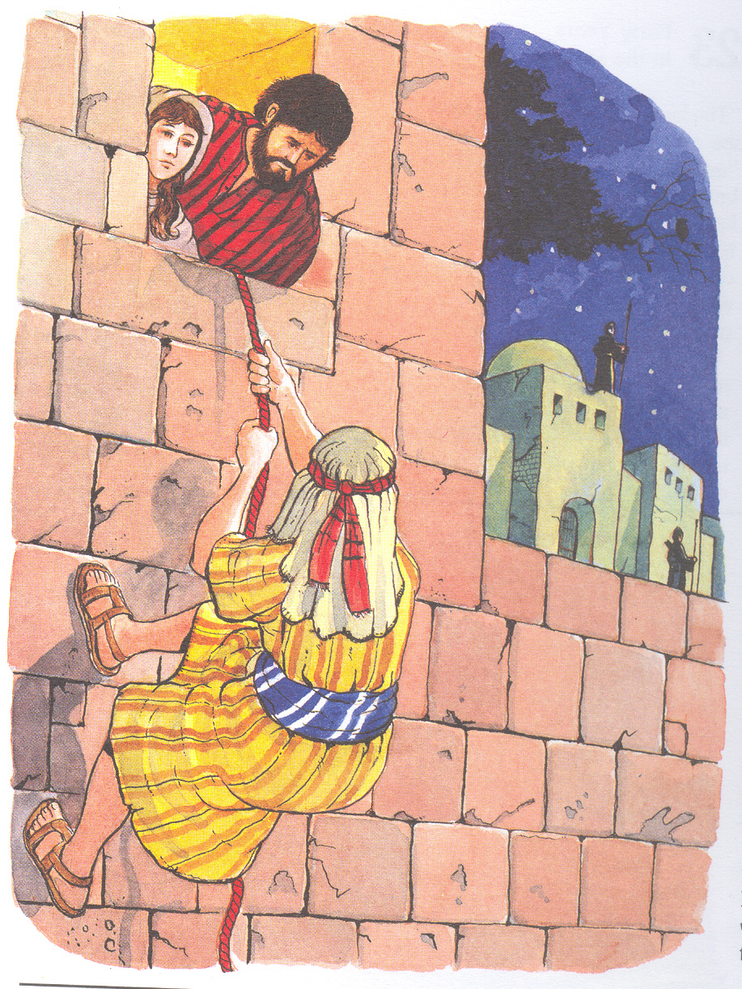
Agreement with Rahab
..so she sent them away and
they departed. And she
tied the scarlet cord in the
window … (Josh. 2:21 NIV)
Now then, please swear to me by the LORD that you will show kindness to my family, because I have shown kindness to you (Josh. 2:12 NIV)

Slide 38
Slides on Joshua 3

Slide 39
Two Crossings
REED (RED) SEA
JORDAN RIVER
Exodus 14
A sea
Moses
Begins the Wanderings
Leaving Egypt
Entering Sinai
Song memorial
Narrow Channel
Took all night
Gave Freedom
Signifies Salvation
168
Joshua 3
A river
Joshua
Ends the Wanderings
Leaving Moab
Entering Canaan
Stone memorial
30km Plain
Took a few hours
Gave Rest
Signifies Glorification

Slide 40
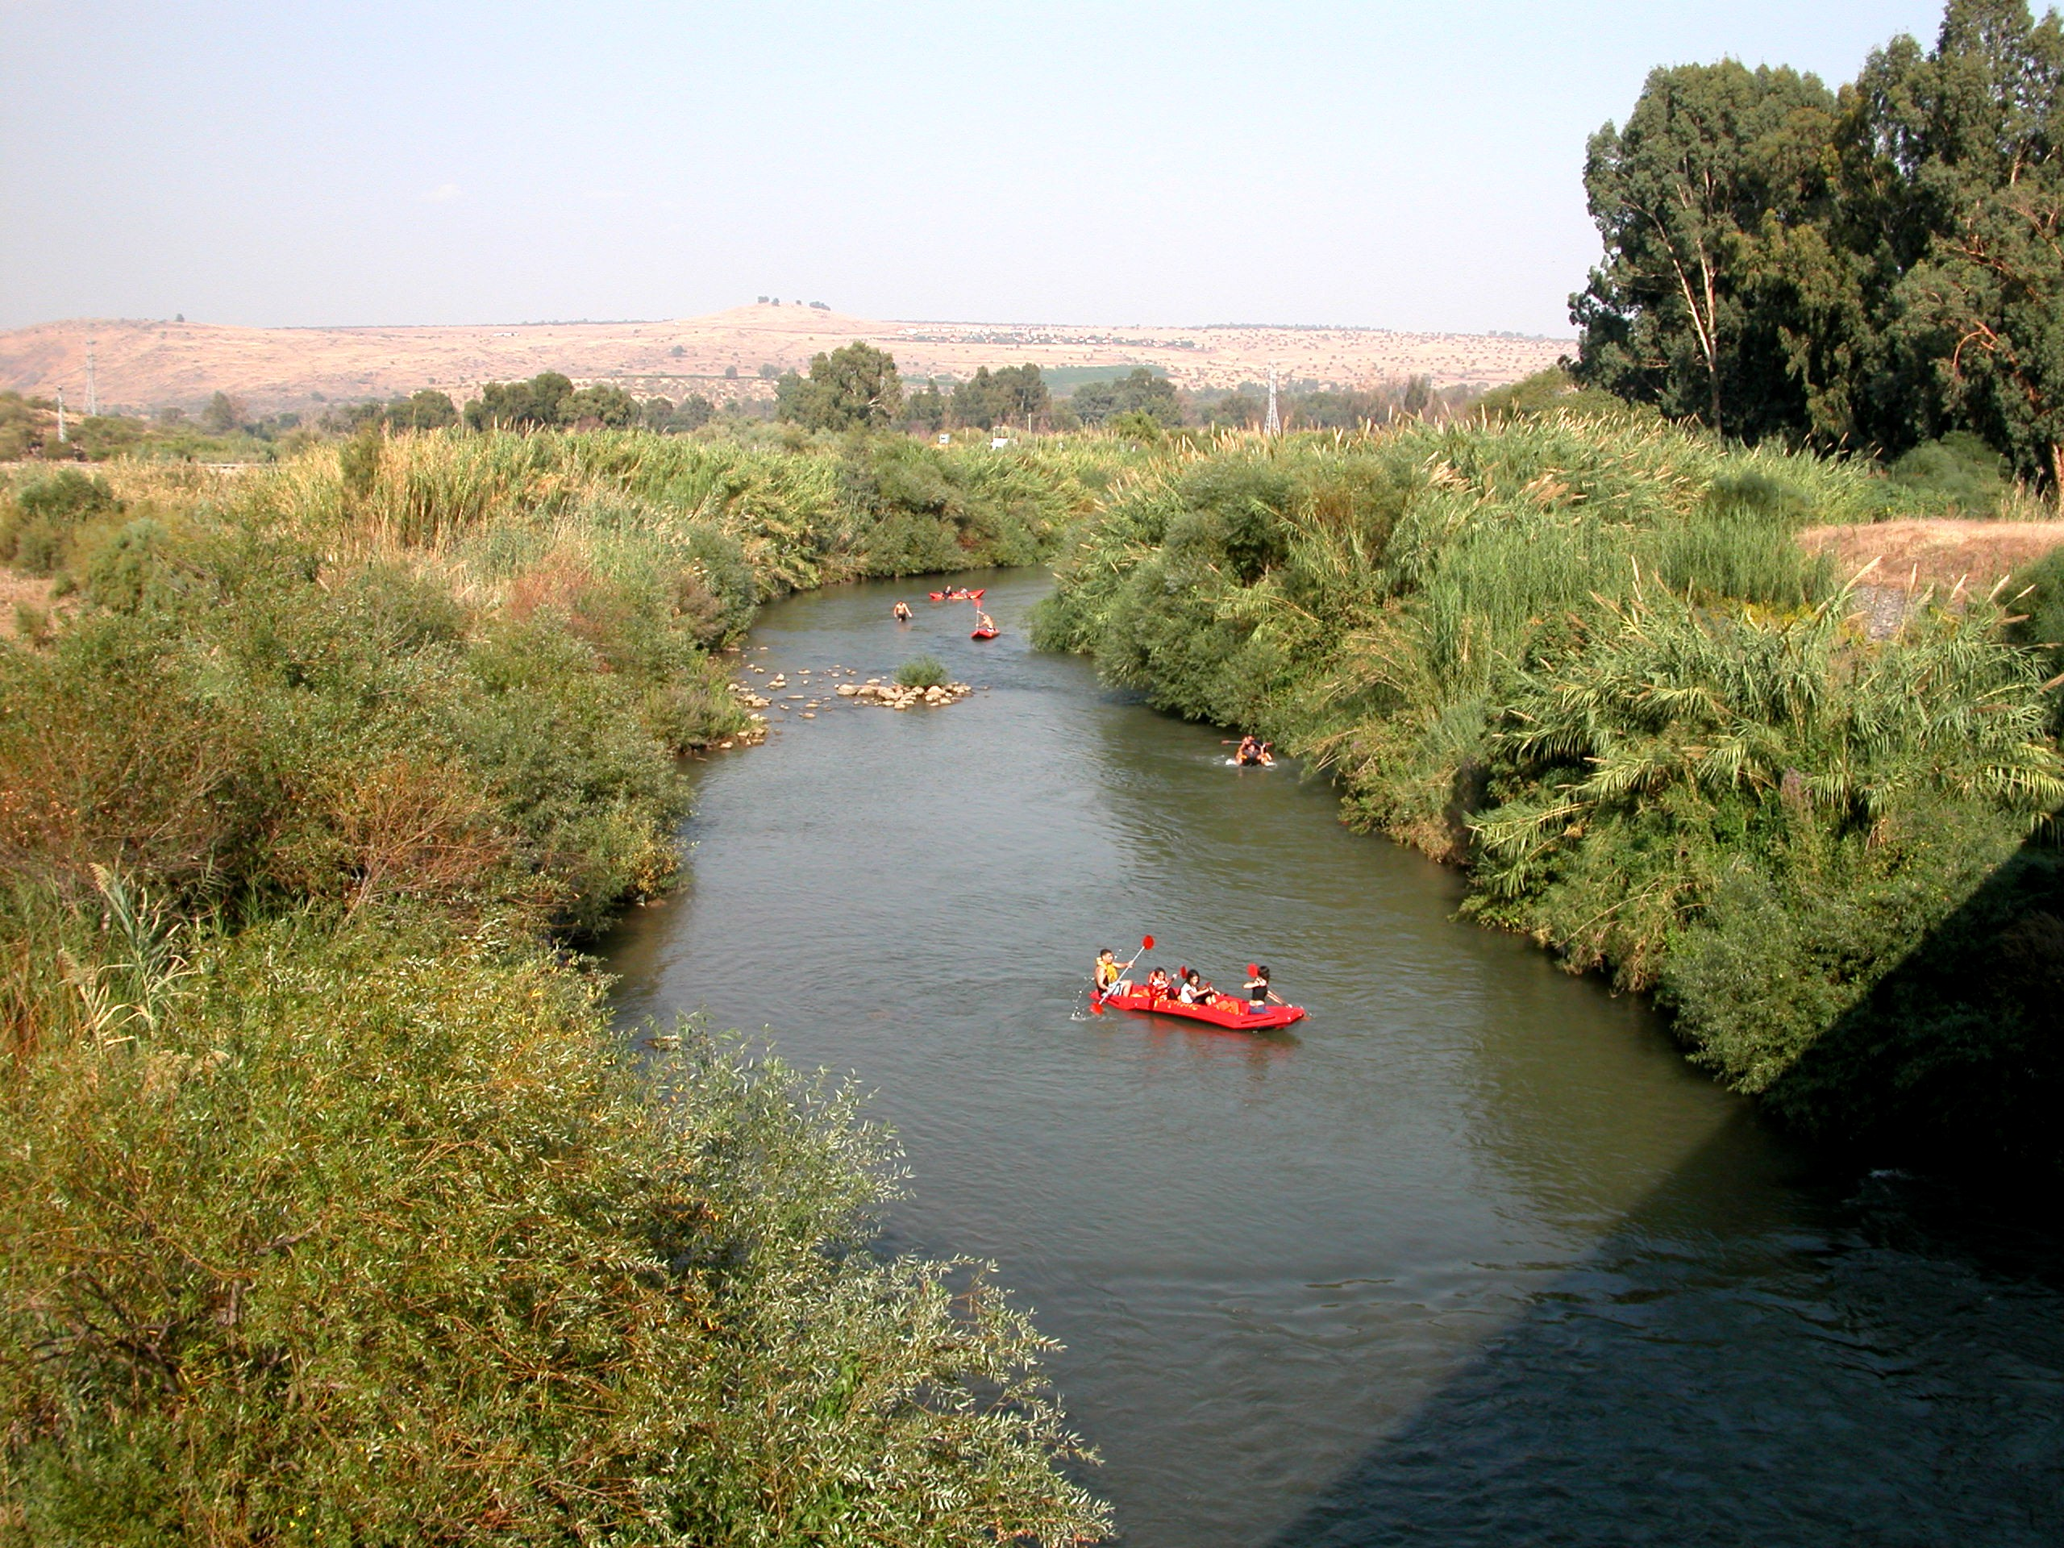
Kayaks on the Jordan

Slide 41
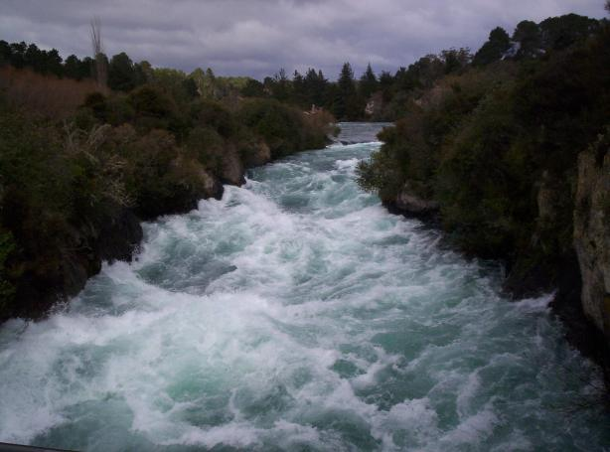
The Raging Jordan!

Slide 42
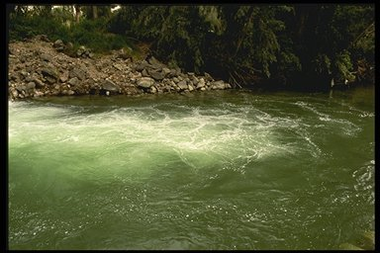
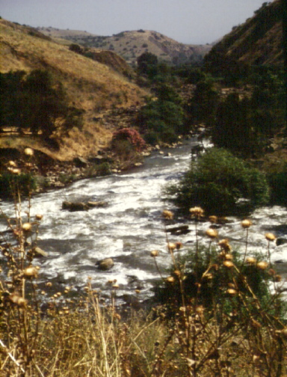
At flood stage
Now the Jordan is at flood stage all during harvest. Yet as soon as the priests who carried the ark reached the Jordan and their feet touched the water's edge…
CROSSING THE JORDAN
… the water from upstream stopped flowing. It piled up in a heap a great distance away, at a town called Adam in the vicinity of Zarethan, while the water flowing down to the Sea of the Arabah (the Salt Sea) was completely cut off. So the people crossed over opposite Jericho (Josh. 3:15-16 NIV)

Slide 43
Slides on Joshua 4

Slide 44
One Man From Each Tribe Set Up Memorial Stones to Recall the Crossing

Slide 45
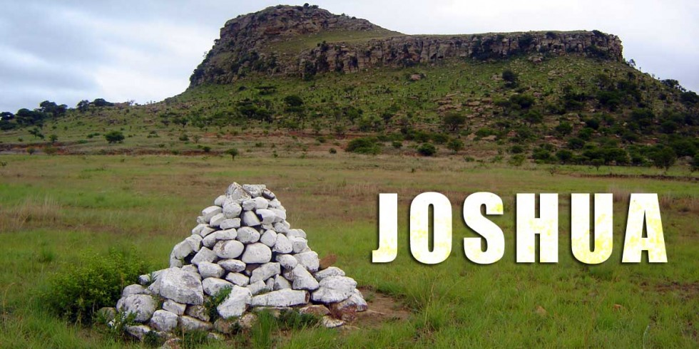
Stones of Remembrance
Joshua 3–4

Slide 46
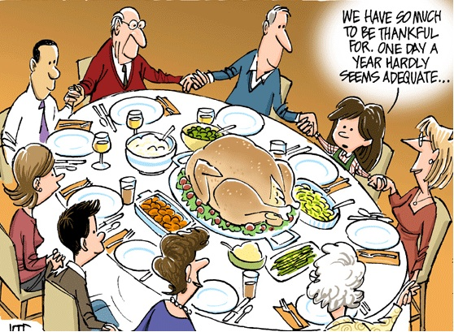
We have so much to be thankful for. One day a year hardly seems adequate…

Slide 47
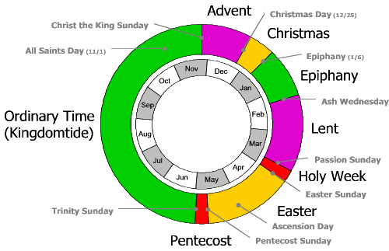
Communal Christian Year
Advent
Christmas Day (12/25)
Christ the King Sunday
Christmas
All Saints Day (11/1)
Epiphany (1/6)
Nov
Dec
Oct
Epiphany
Jan
Sep
Ash Wednesday
Ordinary Time (Kingdomtide)
Feb
Lent
Aug
Mar
Jul
Passion Sunday
Apr
Jun
May
Holy Week
Easter Sunday
Trinity Sunday
Easter
Ascension Day
Pentecost
Pentecost Sunday

Slide 48
Slides on Joshua 5

Slide 49
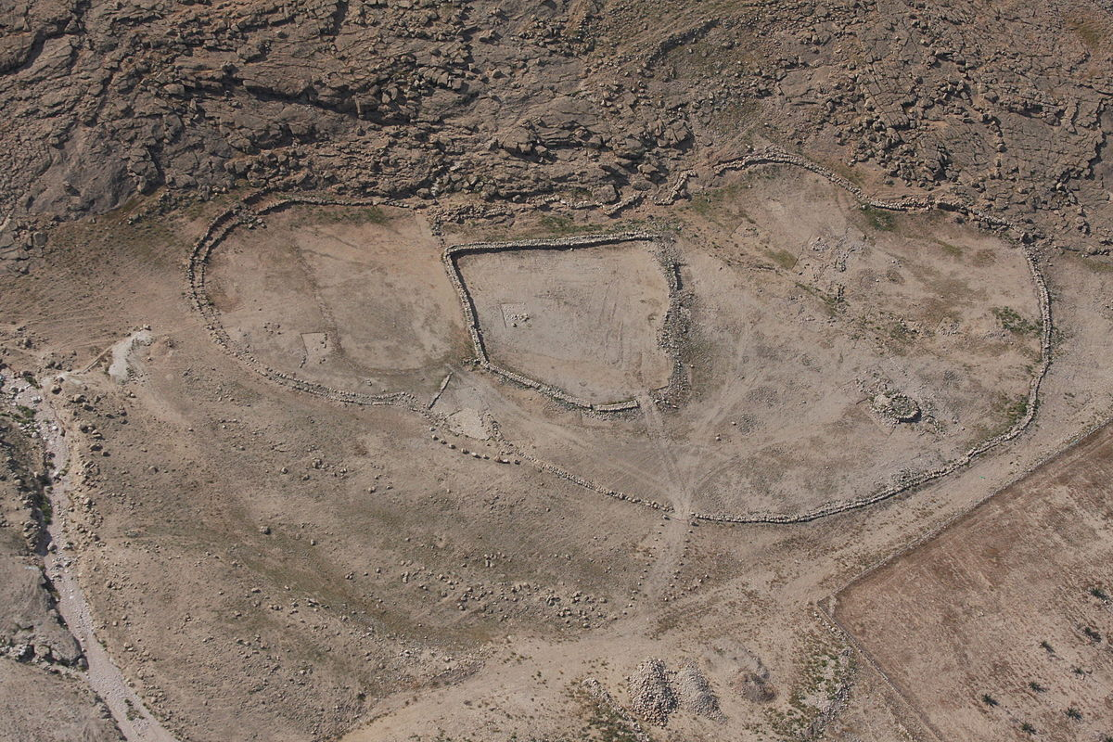
Israelites Enter Gilgal in Canaan

Slide 50
Taking Care of Priorities (Josh 3:2; 5:2-3)
"At that time the LORD told Joshua, 'Make flint knives and circumcise this second generation of Israelites.' ³So Joshua made flint knives and circumcised the entire male population of Israel at Gibeath-haaraloth" (Joshua 5:2-3 NLT).
171
Zebulun
Issachar
Manasseh
Gilgal
Acacia Grove
Jericho
Notes:
Rather than Israel going straight across the Jordan River to Jericho, God had them stop at Gilgal to the north. But why? Their parents had not believed God could bring them into the land 39 years earlier in the desert city of Kadesh-Barnea, and therefore been judged to die in the wilderness (Numbers 13–14). But this older generation also had not followed the covenant sign of circumcision given to Abraham (Genesis 17) by circumcising their baby boys born in the desert. How could they go attack the land as uncircumcised people of God? So God had them do something amazing—to be circumcised right there with Jericho in sight. They named the place Gibeath-haaraloth, or "Hill of Foreskins," for over 600,000 foreskins were stacked on the ground. This took days to heal and left them defenseless against the giants of the land. However, it underscored the priority of spiritual preparation over military readiness.

Slide 51
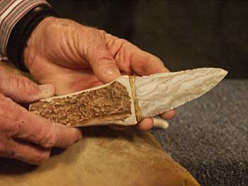
"Make flint knives and circumcise
the Israelites again."
So Joshua made flint knives and circumcised the Israelites at Gibeath Haaraloth.
(Josh. 5:3 NIV)
CIRCUMCISION @ Gilgal

Slide 52
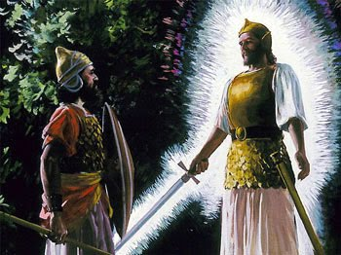
Heroes: Amazing Stories of Faith
As commander of the army of the LORD, I have now come.
Divine Encounter
- Joshua 5:13-15-

Slide 53
Slides on Joshua 6

Slide 54
KEY LESSONS
Rahab chose the fear of the LORD
She is an example of living by faith and not by sight
Did not witness miracles but was convinced that God was powerful enough to take care of her and her family
Her actions showed her faith in God's deliverance

Slide 55
KEY LESSONS
Rahab reveals to us God's ultimate plan of extending salvation to the Gentiles
Her entire family was saved
She became part of the genealogy of Christ
God's faithfulness in fulfilling the
Abrahamic Covenant:
"…and all the peoples of the earth
will be blessed through you"
(Gen 12:3).

Slide 56
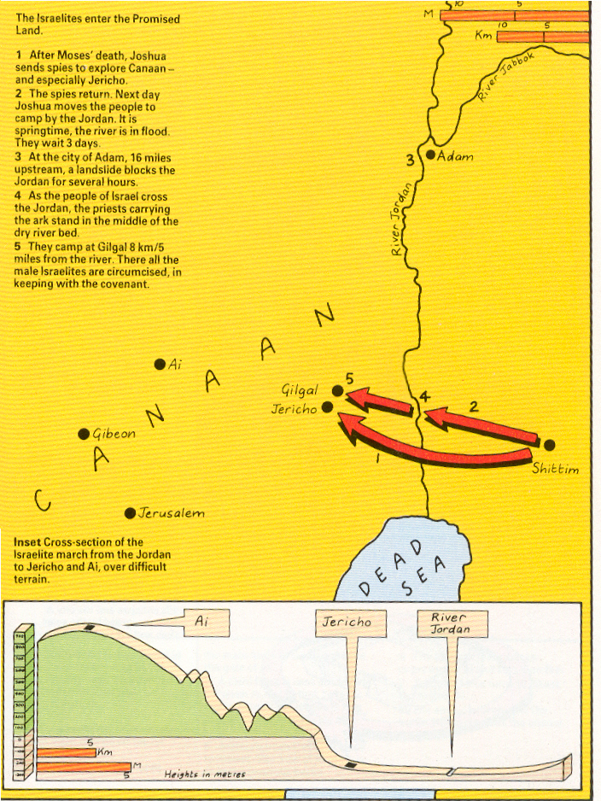
Entering the Promised Land

Slide 57
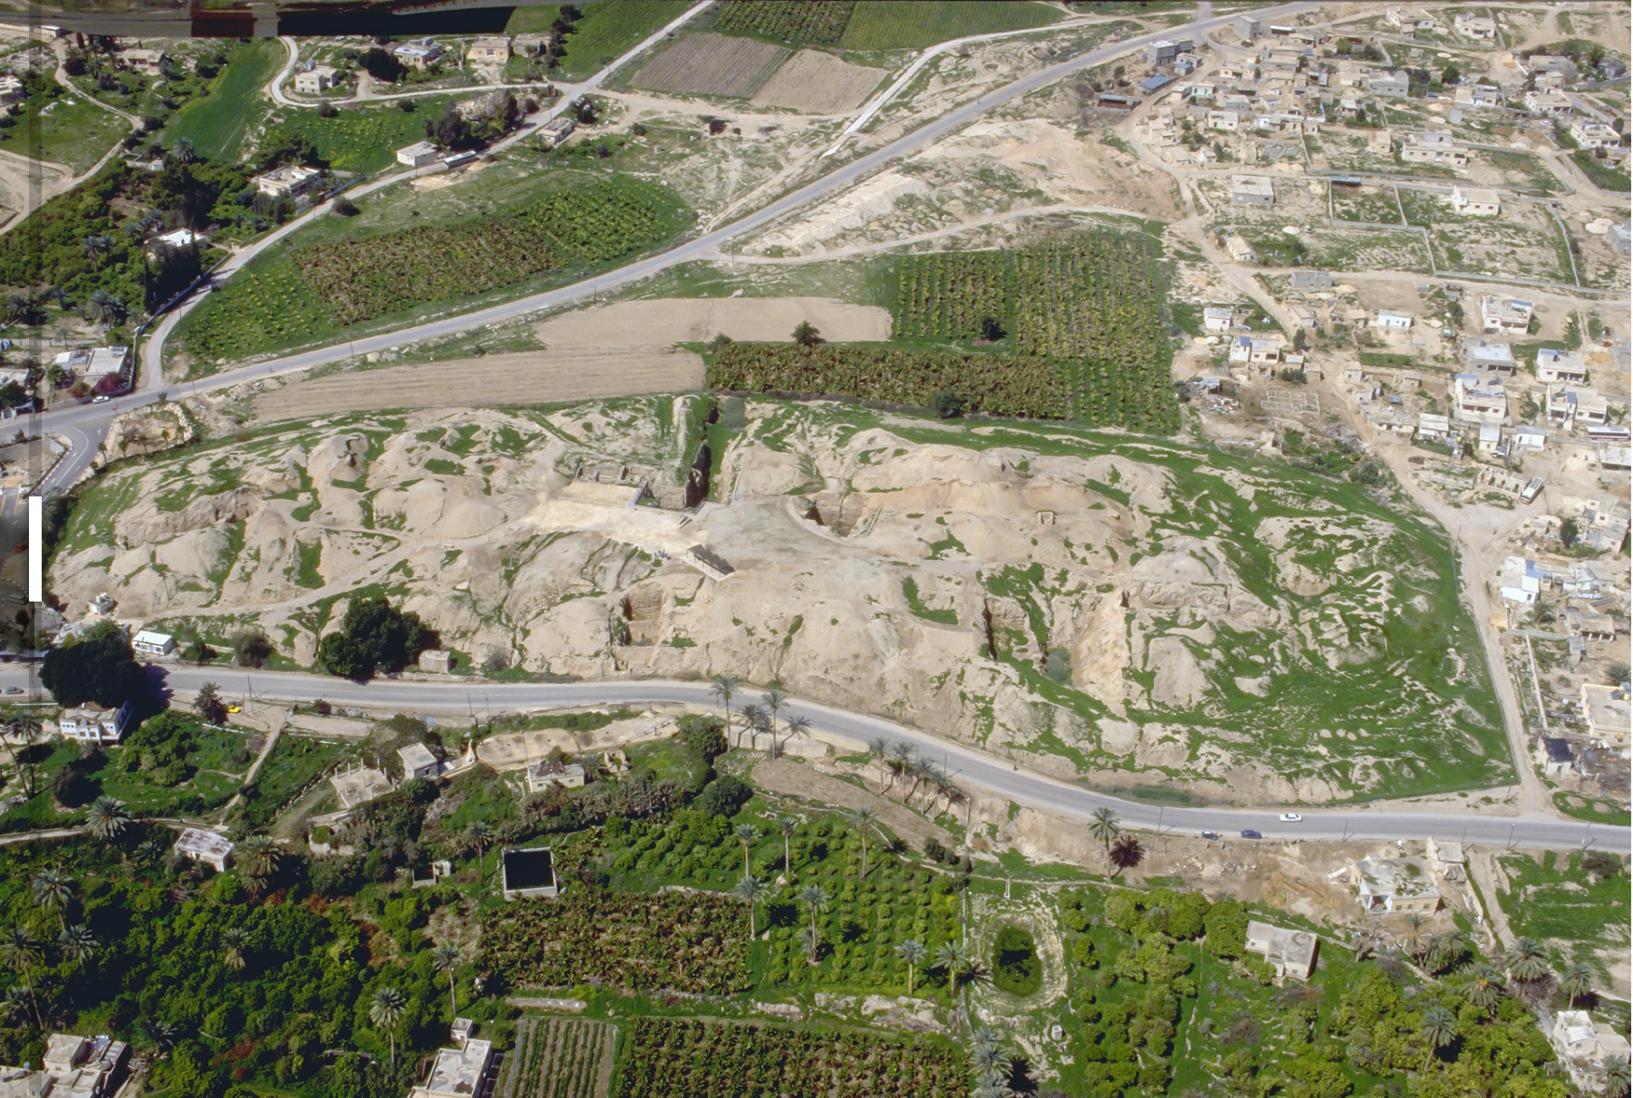
Jericho Ruins Today

Slide 58
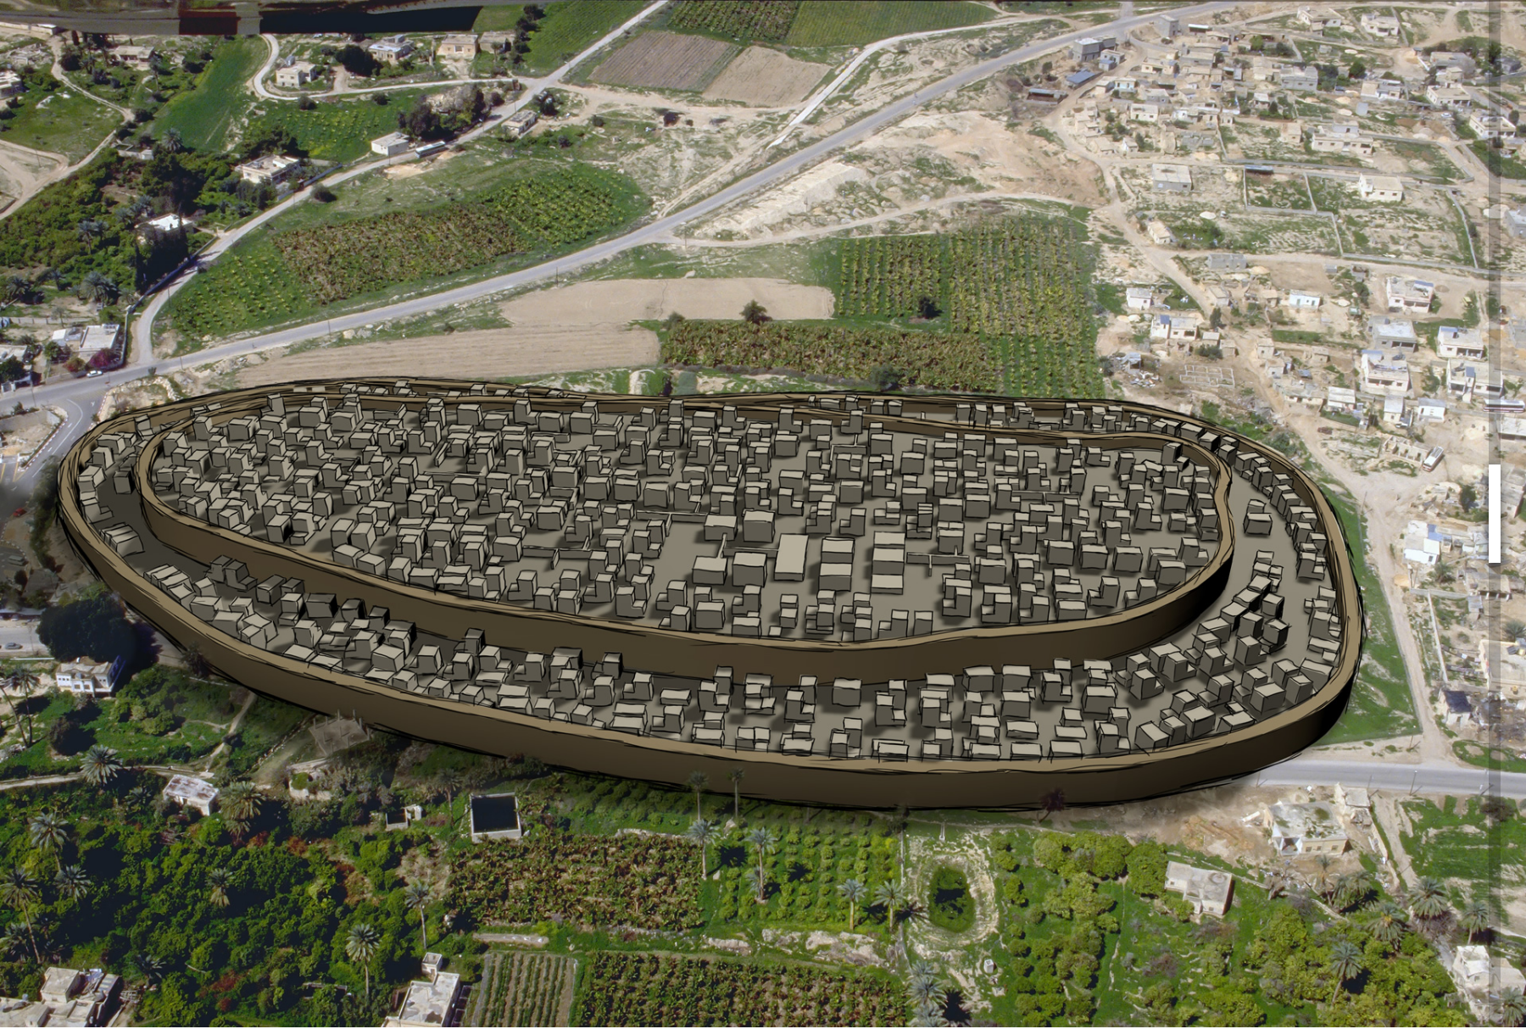
Jericho City Then

Slide 59
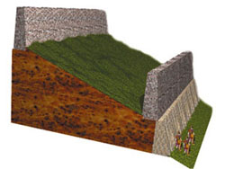
2nd Brick
Rampart
15 m.
2 m. thick,
5-6 m. high
3-4 m. high
Tell Sultan—Schematic cross-section diagram of the fortification system at Jericho based on Kenyon's west trench.—AiG

Slide 60
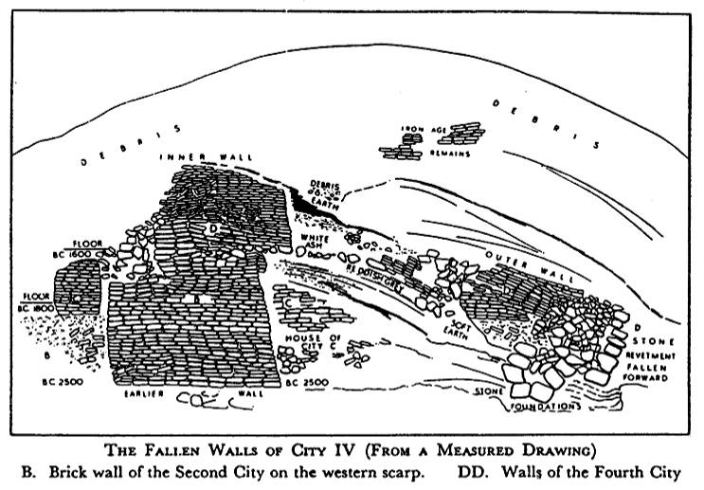
Jericho City
Inner Wall
D
Outer Wall
D
B
The Fallen Walls of City IV (From a Measured Drawing)
B. Brick wall of the 2nd City on the western scarp. DD. Walls of 4th City
Notes:
Note how the walls DD fell outwards to the right which is unique among ancient cities.
Normally battering rams from the outside on the right would cause walls to fall into the city or on top of themselves.
However, God caused an earthquake that was so unique that it forced the walls to fall outwards.
God's grace did not allow Rahab's portion of the wall to collapse, though!

Slide 61
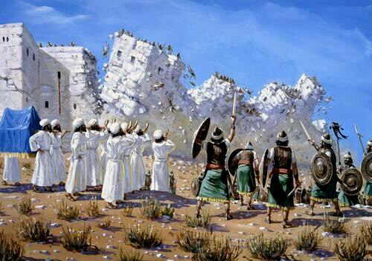
Central Campaign
JERICHO
MARCH
JERICHO
CONQUERED

Slide 62
Slides on Joshua 7

Slide 63
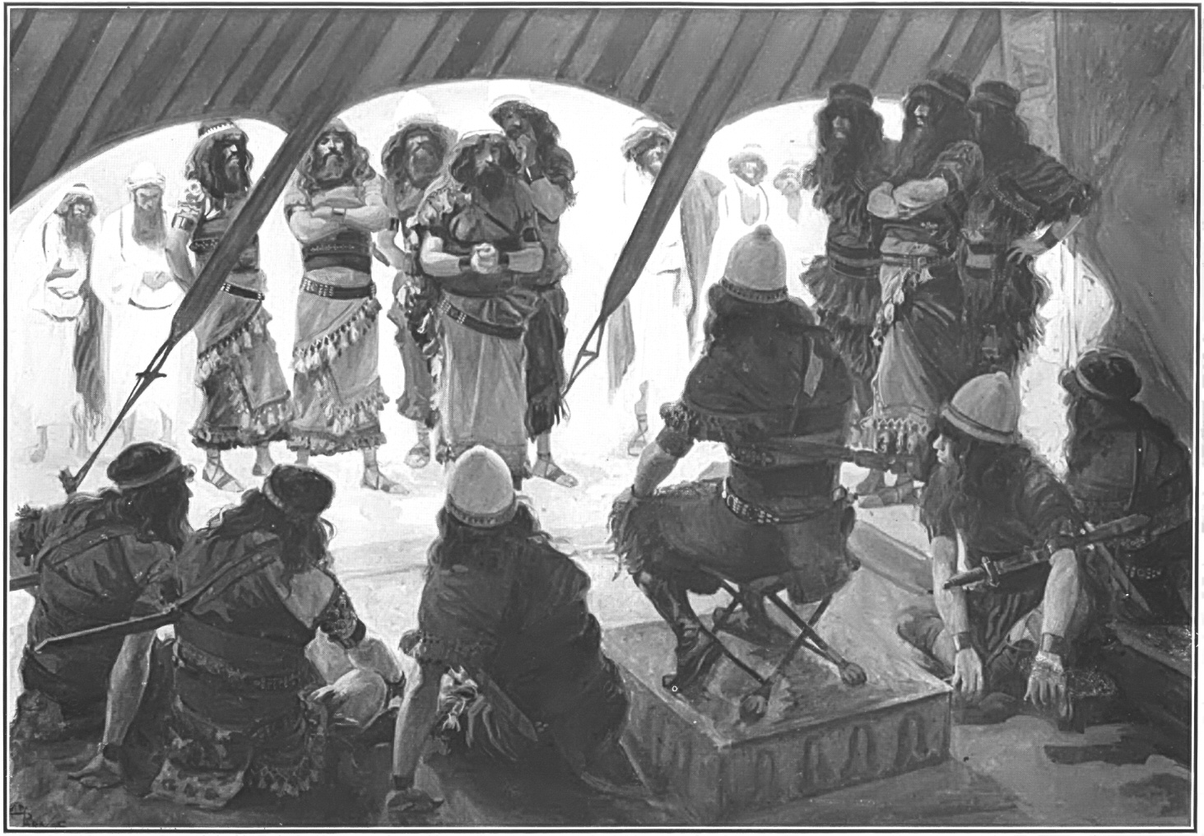
Achan’s Sin (Joshua 7)

Slide 64
CENTRAL
CAMPAIGN
Victory
Over
Enemies
At Ai
Achan's
Sin
Defeat
At
Ai
Sin
Purged

Slide 65
Slides on Joshua 8

Slide 66
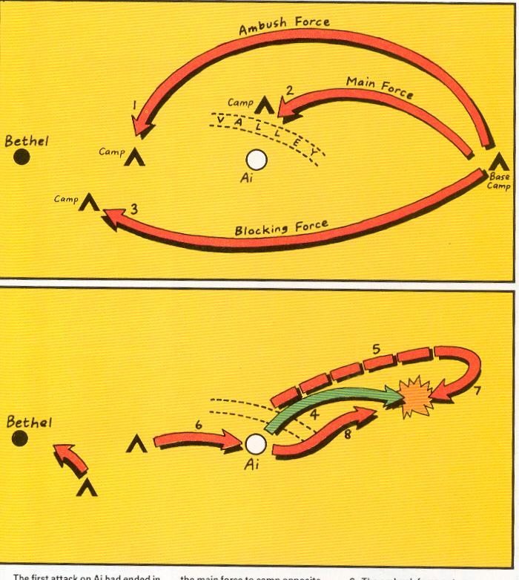
Attack #2 on Ai (Joshua 8)

Slide 67
Attack #2 on Ai (Joshua 8)

Slide 68
Joshua 8 Ai

Slide 69
Slides on Joshua 9

Slide 70
Josh. 9
KEY LESSON
We become vulnerable to
deception if we act
independently from God
and His Word
Victory can be turned into
tragic defeat through
complacency and
disobedience
Israel
Deceived
(did not
consult God)
"… the devil…… he is a liar
and the father of lies"
(John 8:44)

Slide 71
Central Campaign - Rescue of Gibeon

Slide 72
Central Campaign - Rescue of Gibeon

Slide 73
SOUTHERN CAMPAIGN
Beitzel, Moody Atlas of Bible Lands, 97
Israel
Deceived
(did not
consult God)
Battle
Against
the 5
Amorite
Kings
Victory
Over
5
Amorite
Kings
Southern
Cities
Conquered
Josh. 9
Josh. 10

Slide 74
Slides on Joshua 10

Slide 75
The sun stopped in the middle of the sky
and delayed going down about a full day.
Never has there been a day like it before
or since, a day when the LORD listened to
a man.
Joshua 10:13-14 (NIV)

Slide 76
Southern Campaign

Slide 77
Slides on Joshua 11

Slide 78
Northern Campaign

Slide 79
KEY LESSON
Faith and Obedience in GOD
result in victory

Slide 80
Slides on Joshua 12

Slide 81
Conquered Cities (Joshua 12)

Slide 82
We are courageous when we act as if God will fulfill his promises to us.

Slide 83
Starting a School in 1992
no money no backers no parents no teachers no principal no campus
Notes:
Remember that school we helped start? Despite the disadvantages, we still had to take action. We signed the lease for $23,000 monthly with only $1000 in the bank!

Slide 84
Take action.
Notes:
Martin Luther acted in faith by taking on the pope’s claim that paying the church money could pardon sins. The public way to do this was to nail notices on the church door.

Slide 85
Take action.
Notes:
How public are you in your faith?
We are courageous when we act as if God will fulfill his promises to us

Slide 86
The Bottom Line
At the present rate of $600 weekly offerings and $2000 weekly expenses, our $7300 bank balance will be gone in 5.2 weeks.
Notes:
CIC in 2009 received enough funds to last a few years but still no backers. Yet the biggest thing God did was to change my attitude about the need for long-term commitments. Lately we have got morning worship slot and a “new” pastor—me!

Slide 87
The Seminary Guys
Notes:
At the church, God gave me the responsibility to raise up other pastors too. I need to act on this. Three key pastors attend three different seminaries in Singapore, and keeping the church going provides these brothers the training and finances they need.

Slide 88
How can you defeat discouragement that prevents you from doing God’s will?

Slide 89
I. Act like God will keep his Word (Joshua 1–12).
Notes:
Discouragement is inaction, so serve God with faith in his promises.

Slide 90
What results?
Notes:
We conquer discouragement when we actively trust God to keep his Word. So what results from this faith?)

Slide 91
II. Courageous faith brings victory (Joshua 13–24).
Notes:
Trust in God results in his rewards.

Slide 92
Slides on Joshua 13

Slide 93
Transjordan Tribes
140
Joshua 13
Manasseh
Gad
Reuben
Eastern tribes

Slide 94
Slides on Joshua 14

Slide 95
Tribal Boundaries of Israel
171
Manasseh
Joshua 13–17
Manasseh
Gad
Ephraim
Reuben
Judah
Eastern tribes
Firstborn double portion & kingly tribe

Slide 96
Slides on Joshua 18

Slide 97
Drawing Lots

Slide 98
Slides on Joshua 19

Slide 99
Tribal Boundaries of Israel
Naphtali
171
Asher
Zebulun
Manasseh
Issachar
Joshua 13:1–19:48
Manasseh
Gad
Ephraim
Dan
Ammon
Benjamin
Reuben
Judah
Simeon
Moab
Eastern tribes
Firstborn double portion & kingly tribe
Seven tribal allotments by lot
Neighboring nations related by blood
Edom

Slide 100
Slides on Joshua 20

Slide 101
Populations by Tribe
171
Asher 53,400
Naphtali 45,400
Numbers 26 Joshua 13:1–19:48
Zebulun 60,500
Manasseh
Issachar 64,300
Manasseh 52,700
Levi 23,000 Spread Throughout Israel
Gad 40,500
Ephraim 32,500
Dan 64,400
Benjamin 45,600
Reuben 43,730
Judah 76,500
Simeon 22,200

Slide 102
Cities of Refuge
Israel lived in a nomadic culture of personal vengeance by family members against the offending family (blood feuds).
Yet the nation was not ready for legal procedures by an objective village assembly (civil law).
Therefore, God instituted an intermediate step of six nearby cities where one who accidently killed someone could flee.
142
Kedesh
Golan
Ramoth
Shechem
Bezer
Hebron
Numbers 35; Josh. 20:1-9
Notes:
"The idea of providing cities of refuge (Josh. 20:1-9) for capital offenses is rooted in the tension between customary tribal law (retaliation or revenge, in which the blood relative is obligated to execute vengeance) and civil law (carried out less personally by an assembly according to a standard code of justice)" (The Bible Visual Resource Book, 35).

Slide 103
Slides on Joshua 21

Slide 104
48 Levitical Cities
171a
6 Cities of Refuge
Joshua 21

Slide 105
Slides on Joshua 22

Slide 106
God Unites, Sin Divides
Joshua 22

Slide 107
Slides on Joshua 23

Slide 108
Singapore Civilian War Memorial
Four pillars represent WWII unity among the Chinese, Malays, Indians and Westerners

Slide 109
Slides on Joshua 24

Slide 110
Mount Gerizim Looking East (Deut. 27:9-13)
Shechem
Mount Ebal (cursing)
Mount Gerizim (blessing)
Notes:
“Then Moses and the Levitical priests addressed all Israel as follows: ‘O Israel, be quiet and listen! Today you have become the people of the Lord your God. ¹⁰ So you must obey the Lord your God by keeping all these commands and decrees that I am giving you today.’ ¹¹ That same day Moses also gave this charge to the people: ¹² ‘When you cross the Jordan River, the tribes of Simeon, Levi, Judah, Issachar, Joseph, and Benjamin must stand on Mount Gerizim to proclaim a blessing over the people. ¹³ And the tribes of Reuben, Gad, Asher, Zebulun, Dan, and Naphtali must stand on Mount Ebal to proclaim a curse’” (Deut. 27:11-13).

Slide 111
The Goal & the Means
Asher
Naphtali
TRIBAL RESPONSIBILITIES
Manasseh
Zebulun
Issachar
Manasseh
Ephraim
Gad
Dan
Reuben
"Choose this day whom you will serve… but as for me and my house, we will serve the LORD" Joshua 24:15
Benjamin
Judah
Simeon

Slide 112
Renewal of Covenant
Joshua's Charge
Israelite's Response
Stone Monument (Josh. 22)

Slide 113
"But for me and my household, we will serve the LORD"
Joshua 24:15

Slide 114
God will also reward your courage when you stick your neck out for him

Slide 115
International Community School (est. 1993)

Slide 116
ICS now has 480 students!
UK
SWEDEN
KOREA
SWITZERLAND
JAPAN
ITALY
USA
THAILAND
INDIA
MEXICO
ICS
VENUZELA
INDONESIA
BRAZIL
SOUTH AFRICA
AUSTRALIAN

Slide 117
Crossroads People Oct 2017
UK
RUSSIA
FRANCE
MONGOLIA
ITALY
JAPAN
NETHERLANDS
KOREA
LEBANON
CHINA
HONG KONG
TAIWAN
GERMANY
CANADA
MYANMAR
EGYPT
INDIA
USA
MALAYSIA
PHILIPPINES
ZIMBABWE
SINGAPORE
NEW ZEALAND
CIC
INDONESIA
Notes:
Our Oct 2017 church 40 people stem from 13 different countries around the world (44 vcards). Canada (Gloria Lee), China (Charles), Netherlands (Dies & Desiree), Hong Kong (Larry Pun), Cynthia (India), Rena (Indonesia), Yoshie & Kaori (Japan), Naomi (Malaysia), Peng (Myanmar), Miriam (USA), Micah (Philippines), Singapore (Albina), Sarah (UK)
This does not include people who have recently attended only once: Dowon (Korea)
Nor does it include missionaries living back in their countries but still are members of CIC: Maple (Taiwan), Budmaa (Mongolia)

Slide 118
Luther = Reformation

Slide 119
How can you defeat discouragement that prevents you from doing God’s will?

Slide 120
162
SUMMARY STATEMENT
Joshua records Israel's occupation of most of Canaan in fulfillment of
God's faithfulness to His promise
through Joshua's faith in order
to instruct the nation that obedient
faith based upon God's promises
brings blessings

Slide 121
Main Idea of Joshua
God rewards those who take him seriously.

Slide 122
I. Act like God will keep his Word (Joshua 1–12).

Slide 123
What results?

Slide 124
II. Courageous faith brings victory (Joshua 13–24).

Slide 125
How specifically can we defeat discouragement?

Slide 126
KEY LESSONS
Be led by God's presence
God's presence assures victory in the midst of overwhelming situations ("flood waters")
Remind yourself and others of His faithfulness
Recount on His goodness and testify of His works ("memorial stones")

Slide 127
KEY LESSONS
Be set apart to God for His purposes
Circumcision
God's
commitment to the
Abrahamic Covenant: "I will make you into a great nation
and I will bless you"
(Gen. 12:2)
Trust God as Ultimate Redeemer and Provider
" The people ate of the produce of Canaan…" (Joshua 5:11-12 NIV)

Slide 128
Black

Slide 129
OT Preaching link at BibleStudyDownloads.org
Get this presentation and script for free!

